Slide 1
Diagramas – Base

Slide 2











ReleaseManagerChallengeG
timeoff-management-application (fork)
Client machine
Virtual Machine
Port: 9999
Port: 8081
Port: 3333

Slide 3
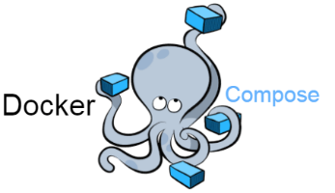
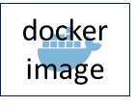


Poll
timeoff-management-
application (fork)
Pull
Checkout
Build
Run
Test
Publish

